Slide 1
UPPER SIXTH ARTS
GEOGRAPHY
Map Analysis 7
Land Use on Maps
Notes:
Good morning, class, and welcome to our geography lesson. I am your geography teacher, Mr Kamdem. Today we are starting Map Analysis 7: Land Use on Maps.

Slide 2
CLASS INFO
Class, Chapter and Duration
Class | Upper Sixth Arts
Chapter | Module 8: Understanding and carrying out statistical techniques, topographic map analysis, fieldwork and project based learning
Duration | 2 periods (2 × 50 minutes)
Notes:
This lesson is for Upper Sixth Arts. It belongs to Module 8: Understanding and carrying out statistical techniques, topographic map analysis, fieldwork and project based learning. We shall need 2 periods to cover it.

Slide 3
IDENTIFICATION
Lesson Identification
Topic | Topographic Map Analysis
Sub-topic | Economic Activity Analysis
Lesson | Map Analysis 7: Land Use on Maps
Notions / Concepts | Land use, agricultural, industrial, recreational land use, spatial pattern.
Syllabus focus | Types of land use (agriculture, industry, mining, recreation, woodland); spatial patterns; links between relief, drainage, vegetation and human activities.
Competence | Learners are able to identify land uses on a map and explain their distribution.
Notes:
Our topic is Topographic Map Analysis, and the sub-topic is Economic Activity Analysis. The key notions we shall use today are: land use, agricultural, industrial, recreational land use, spatial pattern. At the end, you should be able to do this: learners are able to identify land uses on a map and explain their distribution.

Slide 4

HOMEWORK CORRECTION
Correction of the Homework
Question (Map Analysis 6: Transport on Maps):
Draw a topological diagram of the roads in your town and calculate β.
Notes:
Before we start the new lesson, let us correct the homework I gave you at the end of Map Analysis 6: Transport on Maps. The question was: Draw a topological diagram of the roads in your town and calculate β. Take out your exercise books.

Slide 5
HOMEWORK CORRECTION
Correction: Possible Answer
Example: 6 junctions (nodes) and 7 roads between them (links); β = 7 ÷ 6 = 1.17, so the town network has circuits and is fairly well connected.
Notes:
Here is a good answer. Example: 6 junctions (nodes) and 7 roads between them (links); β = 7 ÷ 6 = 1.17, so the town network has circuits and is fairly well connected. Compare it with your own answer and correct your work in red.

Slide 6
LESSON PLAN
Lesson Plan
Correction of the homework
Objectives and recall
Real-life situation and action to take
Learning activities
Board summary
Evaluation, remediation and homework
Notes:
Here is the plan of our lesson today. First, we shall correct the homework. Then we shall look at the objectives and recall what you already know. After that, we shall study a situation from real life and the action to take, and do the learning activities. Finally, we shall copy the board summary, do the evaluation and the remediation, and I will give you the homework.

Slide 7
OBJECTIVES
Objectives
By the end of this lesson, you should be able to:
Identify types of land use from map evidence.
Describe their spatial distribution.
Notes:
Take your time to copy this part; we will continue together.

Slide 8
OBJECTIVES
Objectives (continued)
Explain the links with relief, drainage and vegetation.
Notes:
By the end of this lesson, you should be able to do three things. Number 1: identify types of land use from map evidence. Number 2: describe their spatial distribution. Number 3: explain the links with relief, drainage and vegetation.

Slide 9
PREVIOUS KNOWLEDGE
Previous Knowledge
People farm, mine and build factories.
Maps show plantations and quarries.
Notes:
Let us first remember what you already know. People farm, mine and build factories. Maps show plantations and quarries. Keep this in mind, because we shall build on it today.

Slide 10
REAL-LIFE SITUATION
Situation in Real Life
A map extract shows a plantation on flat land, a quarry on a hill, a factory near a railway and grazing land on slopes. The class must explain why each activity is where it is.
Notes:
Listen carefully to this situation from real life. A map extract shows a plantation on flat land, a quarry on a hill, a factory near a railway and grazing land on slopes. The class must explain why each activity is where it is. Think about it, because I am going to ask you some questions.

Slide 11
REAL-LIFE SITUATION
Situation: Question 1
What is the problem in the situation?
Notes:
Question 1: What is the problem in the situation? Think for a moment, then raise your hand to answer.

Slide 12
REAL-LIFE SITUATION
Answer
The class must explain the location of activities.
Notes:
Good. The class must explain the location of activities.

Slide 13
REAL-LIFE SITUATION
Situation: Question 2
Why is the plantation on flat land?
Notes:
Question 2: Why is the plantation on flat land? Think for a moment, then raise your hand to answer.

Slide 14
REAL-LIFE SITUATION
Answer
It is easy to cultivate and to transport crops.
Notes:
Good. It is easy to cultivate and to transport crops.

Slide 15
REAL-LIFE SITUATION
Situation: Question 3
Why is the factory near the railway?
Notes:
Question 3: Why is the factory near the railway? Think for a moment, then raise your hand to answer.

Slide 16
REAL-LIFE SITUATION
Possible Answer
For transport of raw materials and products.
Notes:
Good. For transport of raw materials and products.

Slide 17
ACTION TO TAKE
Action to Take
Always justify land use with map evidence.
Notes:
From this situation, the action we are working towards in this lesson is the following: always justify land use with map evidence.

Slide 18
JUSTIFICATION
Justification of the Lesson
This lesson helps us to read economic activities on maps.
Notes:
Why is this lesson important for you? This lesson helps us to read economic activities on maps.

Slide 19
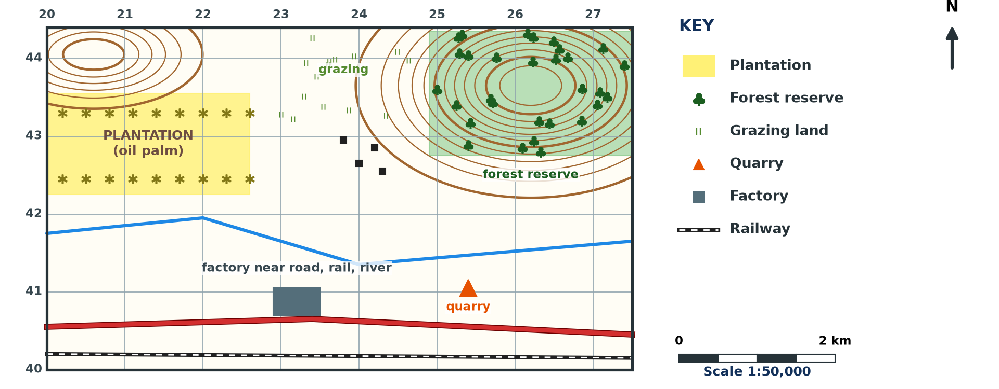
1. TYPES OF LAND USE
Activity 1
Land use on a map (invented).
Notes:
Activity 1. Look carefully at this diagram: land use on a map (invented). Observe every detail before I ask the question.

Slide 20
1. TYPES OF LAND USE
Activity 1: Question
Name four land uses on the extract.
Notes:
Here is the question for Activity 1: Name four land uses on the extract. Take one minute to think and write your answer in your rough notebook.

Slide 21
1. TYPES OF LAND USE
Activity 1: Answer
Plantation, forest reserve, quarry, factory (also grazing).
Notes:
Let us check the answer together. Plantation, forest reserve, quarry, factory (also grazing).

Slide 22

1. AGRICULTURE
Activity 2
An oil palm plantation.
Notes:
Activity 2. Look carefully at this picture: an oil palm plantation. Observe every detail before I ask the question.

Slide 23
1. AGRICULTURE
Activity 2: Question
What map evidence shows plantation agriculture?
Notes:
Here is the question for Activity 2: What map evidence shows plantation agriculture? Take one minute to think and write your answer in your rough notebook.

Slide 24
1. AGRICULTURE
Activity 2: Answer
Regular symbols over a large area with a name like "oil palm estate".
Notes:
Let us check the answer together. Regular symbols over a large area with a name like "oil palm estate".

Slide 25
1. INDUSTRY AND MINING
Activity 3
Factory and quarry.
Notes:
Activity 3. Look carefully at this diagram: factory and quarry. Observe every detail before I ask the question.

Slide 26
1. INDUSTRY AND MINING
Activity 3: Question
Explain the location of the factory.
Notes:
Here is the question for Activity 3: Explain the location of the factory. Take one minute to think and write your answer in your rough notebook.

Slide 27
1. INDUSTRY AND MINING
Activity 3: Answer
It is near the road, railway and river for transport and water.
Notes:
Let us check the answer together. It is near the road, railway and river for transport and water.

Slide 28

1. RECREATION AND FORESTRY
Activity 4
Logs from a forest.
Notes:
Activity 4. Look carefully at this picture: logs from a forest. Observe every detail before I ask the question.

Slide 29
1. RECREATION AND FORESTRY
Activity 4: Question
Why are forest reserves often on hills?
Notes:
Here is the question for Activity 4: Why are forest reserves often on hills? Take one minute to think and write your answer in your rough notebook.

Slide 30
1. RECREATION AND FORESTRY
Activity 4: Answer
Steep slopes are poor for farming and trees protect the soil.
Notes:
Let us check the answer together. Steep slopes are poor for farming and trees protect the soil.

Slide 31
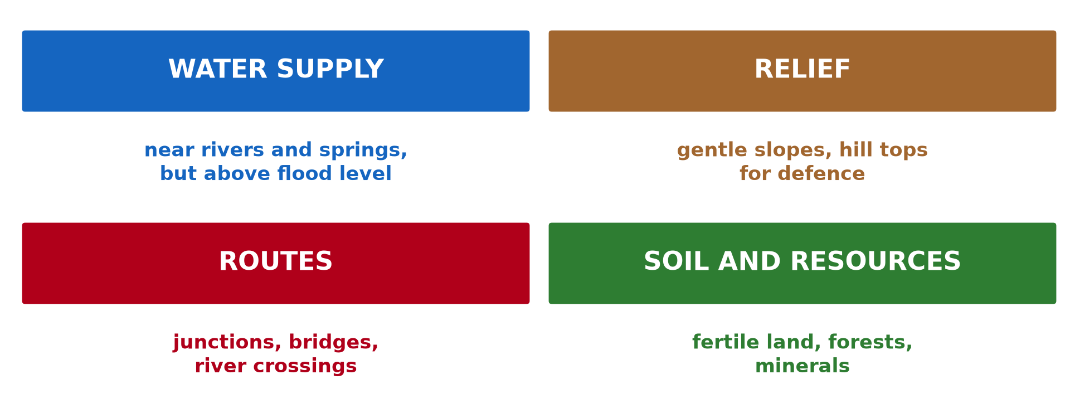
2. PATTERNS AND LINKS
Activity 5
Physical factors of land use.
Notes:
Activity 5. Look carefully at this diagram: physical factors of land use. Observe every detail before I ask the question.

Slide 32
2. PATTERNS AND LINKS
Activity 5: Question
How does relief influence land use?
Notes:
Here is the question for Activity 5: How does relief influence land use? Take one minute to think and write your answer in your rough notebook.

Slide 33
2. PATTERNS AND LINKS
Activity 5: Answer
Flat land is farmed and built on; steep slopes are left for forest or grazing.
Notes:
Let us check the answer together. Flat land is farmed and built on; steep slopes are left for forest or grazing.

Slide 34
BOARD SUMMARY
Board Summary
Topic: Topographic Map Analysis
Sub-topic: Economic Activity Analysis
Map Analysis 7: Land Use on Maps
Notes:
Now we are going to copy the board summary. Write the title and the headings neatly in your notebooks. I will give you enough time for each slide, so do not rush.

Slide 35
BOARD SUMMARY
1. Types of Land Use
The main land uses on maps are the following:
Agricultural land use: Plantations appear as regular symbols over large areas with names like "oil palm estate". Small farms and grazing land are shown by scattered symbols or names.
Notes:
Let us copy Types of Land Use. The main land uses on maps are the following. On this slide we have Agricultural land use. Write each point on a new line, with the key term first, and explain it in your own words when we revise. When you finish, we go to the next slide.

Slide 36
BOARD SUMMARY
1. Types of Land Use (continued)
Industrial and mining land use: Factories, quarries, mines and power stations are shown by symbols or names. They are often near roads, railways and rivers.
Notes:
We continue with Types of Land Use. On this slide we have Industrial and mining land use. Write each point on a new line, with the key term first, and explain it in your own words when we revise. When you finish, we go to the next slide.

Slide 37
BOARD SUMMARY
1. Types of Land Use (continued)
Recreational and woodland use: Parks, golf courses, rest houses and forest reserves show recreation and forestry. Forest reserves are often on hills.
Notes:
We continue with Types of Land Use. On this slide we have Recreational and woodland use. Write each point on a new line, with the key term first, and explain it in your own words when we revise.

Slide 38
BOARD SUMMARY
1. Types of Land Use
Illustration: land use on a map (invented)
Notes:
Now draw this illustration in your notebook: land use on a map (invented). Give it a title and label it clearly.

Slide 39
BOARD SUMMARY
2. Spatial Patterns and Links
Land use is linked to physical factors as follows:
Relief: Flat land is farmed and built on, while steep slopes are left for forest or grazing. Quarries use exposed rock on hills.
Notes:
Let us copy Spatial Patterns and Links. Land use is linked to physical factors as follows. On this slide we have Relief. Write each point on a new line, with the key term first, and explain it in your own words when we revise. When you finish, we go to the next slide.

Slide 40
BOARD SUMMARY
2. Spatial Patterns and Links (continued)
Drainage and vegetation: Swamps limit farming, but rivers supply water for factories and crops. Forest areas give timber and protect slopes.
Human activity: Settlements and roads attract markets, factories and services. Land use becomes more intensive near towns.
Notes:
We continue with Spatial Patterns and Links. On this slide we have Drainage and vegetation and Human activity. Write each point on a new line, with the key term first, and explain it in your own words when we revise.

Slide 41
BOARD SUMMARY
2. Spatial Patterns and Links
Illustration: physical factors of land use
Notes:
Now draw this illustration in your notebook: physical factors of land use. Give it a title and label it clearly.

Slide 42
FORMATIVE EVALUATION
Evaluation 1
Give two pieces of map evidence of industry.
Notes:
Now let us check what you have understood. Question 1: Give two pieces of map evidence of industry. Answer in your exercise book.

Slide 43
FORMATIVE EVALUATION
Expected Answer
A factory symbol and a railway siding (or a quarry).
Notes:
The expected answer is: a factory symbol and a railway siding (or a quarry). If you got it right, well done.

Slide 44
FORMATIVE EVALUATION
Evaluation 2
Explain the location of a plantation.
Notes:
Now let us check what you have understood. Question 2: Explain the location of a plantation. Answer in your exercise book.

Slide 45
FORMATIVE EVALUATION
Expected Answer
Flat land, fertile soils, near roads for transport.
Notes:
The expected answer is: flat land, fertile soils, near roads for transport. If you got it right, well done.

Slide 46
REMEDIATION
Remediation
Fill in the blanks:
The way land is used is land ______.
Quarries are on ______ ground.
Plantations cover ______ areas.
Notes:
For those who need more practice, fill in the blanks in your exercise book. The answers are: number 1, use; number 2, high (rocky); number 3, large.

Slide 47
HOMEWORK
Homework
Map the land uses along the road from your home to school.
Notes:
For your homework: Map the land uses along the road from your home to school. We shall correct it at the beginning of our next lesson.

Slide 48
NEXT LESSON
Next Lesson
Our next lesson will be on:
Map Analysis 8: Rural Settlements on Maps
Notes:
Our next lesson will be on Map Analysis 8: Rural Settlements on Maps. Thank you for your attention, and see you next time.

Slide 49
BILINGUAL GAME
Bilingual Game (Jeu Bilingue)
English | Français
Land use | L'utilisation du sol
Plantation | La plantation
Quarry | La carrière
Grazing | Le pâturage
Factory | L'usine
Reserve | La réserve
Notes:
Let us play the bilingual game. I say a word in English, and you give me the French word. Then we do the reverse.

Slide 50
LOGBOOK
Official Logbook (1/2)
Module / Topic | Topographic Map Analysis
Lesson Title | Map Analysis 7: Land Use on Maps
Expected Learning Outcomes | Identify types of land use from map evidence. Describe their spatial distribution. Explain the links with relief, drainage and vegetation.
Competence | Learners are able to identify land uses on a map and explain their distribution.
Notes:
I record this information in the official logbook of the class after the lesson.

Slide 51
LOGBOOK
Official Logbook (2/2)
Matter Taught | Types of Land Use; Spatial Patterns and Links.
Evaluation | Formative evaluation and remediation exercise.
Homework | Map the land uses along the road from your home to school.
Enrolment / Present / Absent | ____ / ____ / ____
Achievement | To be completed after the lesson.
Notes:
I complete the second page of the logbook: the matter taught, the evaluation, the homework and the attendance.

Slide 52
TEACHER'S NOTE
Teacher's Note
Timing: Homework correction, plan, objectives 8 min | Recall, situation, action 10 min | 5 activities 30 min | Board summary (copying) 30 min | Evaluation, remediation 10 min | Homework, next lesson 5 min | Logbook 7 min
Without the projector (Activity 1): list land uses.
Without the projector (Activity 2): find evidence.
Without the projector (Activity 3): explain the location.
Without the projector (Activity 4): discuss reserves.
Without the projector (Activity 5): relate land use to relief.
Notes:
This slide is for me, the teacher: it gives the timing of the lesson and what to do if the projector is not available.

Slide 53
REFERENCES
References
National Geography Syllabus, MINESEC/IGE/IP-SS, 2019 — Module 8 (Practical Geography).
Photo, Activity 2: “Aerial view of oil palm plantation” by CIFOR, CC BY-NC-ND 2.0, via Flickr (https://www.flickr.com/photos/45423546@N07/38802487905)
Photo, Activity 4: “Logging truck, Cameroon” by World Resources, CC BY-NC-SA 2.0, via Flickr (https://www.flickr.com/photos/26107309@N05/4764354366)
Diagrams and animations: drawn for this lesson (Geography Department).
Notes:
These are the references and picture credits used to prepare this lesson.

